Slide 1
YOUR KEY TO CHAMPIONING YOUR BIOTECHNOLOGY CAREER
www.elisatests.in | your student resource

Slide 2
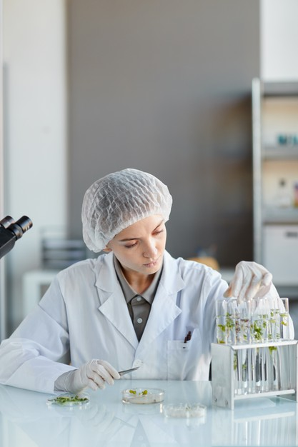
TABLE OF CONTENT
PERSPECTIVE ON THE INDUSTRY
WHAT EXACTLY IS BIOTECHNOLOGY
PATHWAY TO A CAREER IN BIOTECHNOLOGY
BIO TECHNOLOGY TRENDS
EXTREMELY IMPORTANT BIOTECHNOLOGY SKILLS
THE BENEFITS OF AN ADVANCED STUDY
www.elisatests.in | your student resource

Slide 3
PERSPECTIVE ON THE INDUSTRY
It's no surprise that the biotech business is booming, given its boundless potential to improve healthcare.
According to a 2020 analysis from Industry ARC, the biotech business will be worth more than $610 billion by 2025, thanks in large part to developments in artificial intelligence and agricultural applications.
This expanding industry creates more job possibilities at pharmaceutical corporations, biotech startups, research institutes, and other organizations. Professionals with interdisciplinary knowledge of biology, chemistry, chemical engineering, and pharmaceutical science, as well as high-value business abilities, will be in high demand for these positions.
“Biotechnology is a vibrant global industry,” says Dr. Kalpesh Jain, COO at Krishgen Biosystems. “You must prepare yourself holistically for working in such a competitive, cross-cultural discipline.” If you want to be a leader in the biotechnology business, this handbook will help you improve your career and achieve your objectives.
www.elisatests.in | your student resource

Slide 4
WHAT EXACTLY IS BIOTECHNOLOGY
Biotechnology is the process of developing new medications and biological products by manipulating microbes.
Biotechnologists, in other words, use living creatures such as bacteria to develop novel medicinal therapies.
The discipline spans all phases of a product's lifecycle, from research and development through commercialization.
Since many people who enter the biotech business aspire to be scientists, there are hundreds of career paths and expertise available in this quickly expanding business.
Continue reading to learn how to choose the ideal career route for you based on your interests, abilities, and industry trends.
www.elisatests.in | your student resource

Slide 5
PATHWAY TO A CAREER IN BIOTECHNOLOGY
Biotechnology careers are predicted to rise in the next years, notably in San Francisco and Boston, the two main biotech businesses in the United States. In India the main biotech corridors are Bengaluru, Hyderabad and Pune.
The Boston area is home to over 1,000 biotech enterprises, and venture capital investment in the region totaled $5.2 billion in 2018.
The three major biotech hubs in India account for over 70% of the biotech investments and turnover.
Jobs in the biotech business have expanded 94 percent in Massachusetts alone in the previous 15 years, and the industry as a whole is expected to increase 8.3 percent more in the next five years.
The average annual pay for biotech workers is $94,490- (In India it is Rs3,00,000- for a fresher post graduate to Rs10,00,000- for a PhD candidate) with pay varied depending on your individual function at your company or lab.
Many people who pursue an advanced degree in biotechnology intend to work as scientists; however, positions in biotech businesses and labs' operations, production, sales, marketing, and strategy departments are also available.
In addition to these possibilities, some professionals prefer to work in academia rather than biotech labs or business.
www.elisatests.in | your student resource

Slide 6
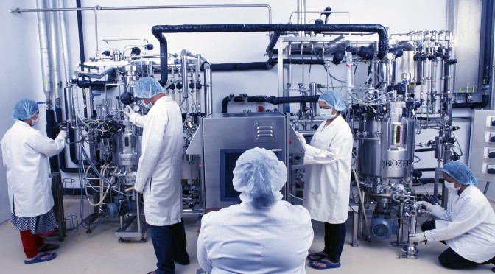
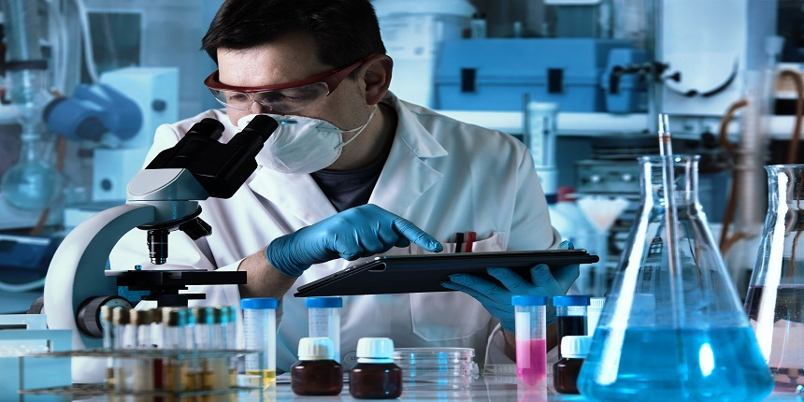
Here are some of the most in-demand biotech jobs right now….
Biomedical Engineer -
Biomedical engineers create biomedical equipment, devices, and software that aid in the advancement of medicine.
Working on artificial organs, prostheses, and diagnostic devices, among other instruments, might be part of a project. Many engineers work in manufacturing, but there are also opportunities at universities, hospitals, and research centers.
Biochemist -
As a biochemist you will investigate the chemical properties and biological processes of living things, such as cell development and growth, heredity, and how disease interacts with each of these. Biochemistry is the study of proteins, lipids, DNA, carbohydrates, and other substances.
Medical Scientist -
Medical scientists are in responsible of conducting clinical trials and supervising all research associated with them, hence the majority of their work is done in laboratories. Preparing and analyzing medical samples, standardizing drug strength and dosage, and contributing to mass manufacturing and distribution systems are all examples of duties.
www.elisatests.in | your student resource

Slide 7
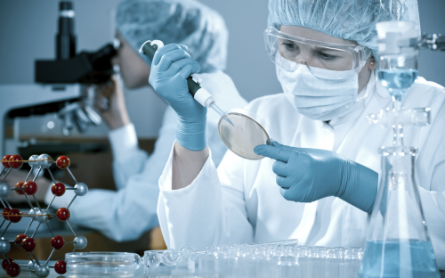
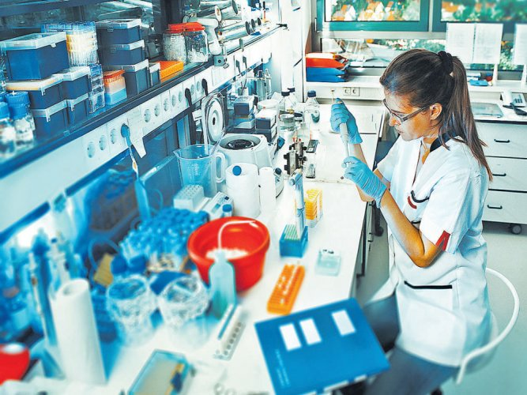
Here are some of the most in-demand biotech jobs right now…. continued…
Process Development Scientist-
Process development scientists supervise manufacturing processes within labs, giving close attention to product quality and efficiency at all phases.
These researchers also devise techniques for scaling a medicine or the manufacture of medical devices without jeopardizing their quality to ensure a safe product, adhere to the company's criteria.
Lab Manager -
Lab managers are in charge of the lab's operations, training, safety protocols, and upkeep. Their job entails a wide range of responsibilities, from procuring supplies and keeping the lab clean to overseeing lab projects and acting as a contact between staff and key stakeholders.
Professionals in this area should have excellent communication skills as well as a deep awareness of the business, as each lab will have unique management requirements based on its specialization.
www.elisatests.in | your student resource

Slide 8
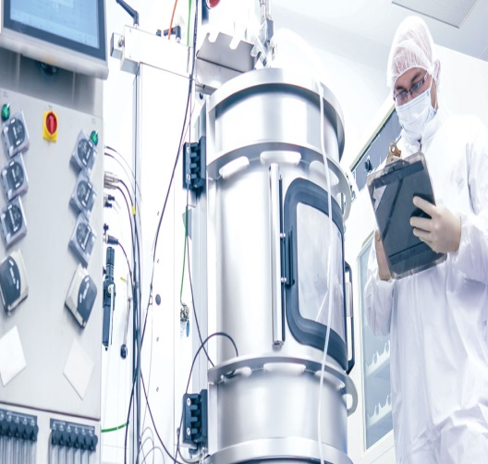
Here are some of the most in-demand biotech jobs right now…. continued…
Bio manufacturing Specialist –
Before a product can be sold, biomanufacturing professionals must ensure that it meets purity, safety, potency, and quality standards. This position necessitates extensive understanding of federal, state, and industry regulatory standards, as well as experience with large-scale production.
Business Development Manager –
Business development managers undertake thorough market analysis and research to assist organizations in developing investment and growth strategies. They assist in assessing and pursuing prospects for organizational growth, acquisition, and joint research.
Director of Strategy and Commercialization –
These biotech specialists plan and carry out new product launch, market development, marketing, sales, and logistics strategies. Successful directors promote their firms' growth and profitability while adhering to the industry's high quality and regulatory standards.
www.elisatests.in | your student resource

Slide 9
BIOTECHNOLOGY TRENDS
Understanding rising trends in biotechnology might help you decide on a career path and keep up with breakthroughs that may have an impact on your current position. Here are some of the important trends influencing the market today.
Monoclonal Antibodies and Biosimilars -
Monoclonal antibodies are laboratory-created antibodies that help the immune system by repairing, augmenting, or mimicking system responses.
They can recognize cancer cells and deliver radiation to precise locations, making them an important tool in disease elimination.
Combining these antibodies with medications in novel ways may make it easier to control illnesses for which there are presently no viable treatments or which require costly medication.
Meanwhile, biosimilars are being developed to have the same effects as existing drugs but with slightly different compositions. Biosimilars, like generic pharmaceuticals, make immunotherapy and targeted therapeutic therapies more accessible, much as they do for synthetic-based treatments.
www.elisatests.in | your student resource

Slide 10
BIOTECHNOLOGY TRENDS
Cell and Gene Therapies –
According to Auclair, customized medications in the form of cell and gene therapies are booming. In 2017, the FDA authorized Kymriah, the first-ever gene therapy. To treat acute lymphoblastic leukaemia, the medicine employs the patient's own white blood cells. Since then, the gene and cell therapy markets have grown by a factor of two, and experts believe that the FDA will continue to approve novel therapies at a rapid pace.
Vaccine Development –
The COVID-19 pandemic has prompted scientists to examine novel approaches to vaccine development. Moderna, for example, created a candidate that generates an immune response by using mRNA from the novel coronavirus rather than a weakened version of the virus itself.
Next-Generation Computing Technology –
Machine learning, artificial intelligence, and other advanced computing techniques have enabled businesses to expand their reach. Research and manufacturing efficiency are now at an all-time high.
Cloud computing has also had an impact on biotechnology. Early-stage firms can now rely on rented cloud storage space rather than investing in their own hardware, freeing up their limited money for R&D prospects.
www.elisatests.in | your student resource

Slide 11
BIOTECHNOLOGY TRENDS
Increased Stakeholder Collaboration –
Biotechnological research necessitates ongoing collaboration with a wide range of stakeholders, from lab associates to multinational collaborators.
More businesses are turning to innovative software technologies that offer data sharing, speedy communication, and virtual meetings to encourage productive cooperation.
Improved Clinical Trials –
Clinical studies, which were once mostly manual, have been significantly computerized. Companies can now investigate disease using readily available technology, such as the Apple Watch and genetic testing.
Trials are now more accessible to a bigger, more geographically diversified range of individuals thanks to widespread digitization. Machine learning can also be used by researchers to more readily reject individuals who do not satisfy trial requirements, examine therapy efficacy, and determine new findings from prior trials.
www.elisatests.in | your student resource

Slide 12
BIOTECHNOLOGY TRENDS
Advances in Personalized Treatment –
For decades, biotechnology and gene-based medicines have gone hand in hand. Scientists have achieved tremendous advances in recent years as a result of advances in technology.
The cost of genetic sequencing has declined considerably, from $2.7 billion in 1990 for the Human Genome Project to less than $300 now, allowing for more in-depth patient analysis and tailored treatment. Personalized cancer treatments, like as CAR T-cell therapy, have already become a reality as a result of faster, more cheaper sequencing.
Agricultural Applications –
According to the United Nations, the world's population will exceed 9.7 billion by 2050, necessitating more sustainable food supplies and efficient land usage.
Gene editing could result in crops that flourish in harsher environments or produce bigger yields in smaller areas while maintaining nutritional value.
www.elisatests.in | your student resource

Slide 13
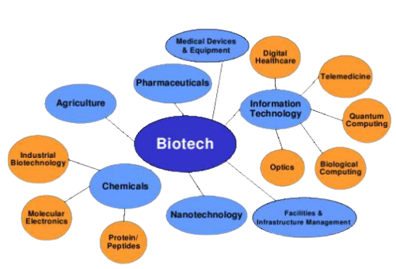
EXTREMELY IMPORTANT BIOTECHNOLOGY SKILLS –
Scientific and Technical Skills –
A solid foundation in scientific and technological abilities can help you keep up with biotechnology's rapid breakthroughs. Knowledge gaps include the following:
Cellular Culture & Biology
Molecular Biology
Chemical Analysis
Purification
Research Methodology
Drug Development
Clinical Research
Lab Research
Genetics
Data Management and analysis
Regulation and compliance
www.elisatests.in | your student resource

Slide 14
EXTREMELY IMPORTANT BIOTECHNOLOGY SKILLS –
Soft Skills and Business Acumen-
Professionals that can work well with others, speak clearly, and continue to learn will be among the most successful in biotechnology career.
As you progress, formulating and implementing strategy, which needs excellent people skills, will become just as crucial as technical understanding.
Communication
Attention to detail
Business Strategy
Research
Problem Solving
Project and budge management
Organization
Time Management
www.elisatests.in | your student resource

Slide 15
THE PERKS OF AN ADVANCED DEGREE
Earning an advanced degree, which can provide you with the skills you need to make a difference in the biotech business, is one of the most reliable methods to contribute to its worldwide effect.
A master's degree takes two to three years to complete and gives students with a comprehensive understanding of the discipline.
Hands-on learning experiences enable you to address changing industry needs, making it a great degree for anybody interested in working in a lab or biotech company.
Your education will teach you not only the scientific, technical, and business skills you'll need, but also leadership and teamwork strategies that will help you become a more valuable employee.
A PhD can take up to eight years to complete and is intended for those who want to work in academia or research. It teaches a more specialised perspective on biotechnology, with a focus on research skills, industry literature, and other academic competencies. Students will still be exposed to lab equipment and other technical skills, but the emphasis will be on academic preparation.
www.elisatests.in | your student resource

Slide 16
EXTREMELY IMPORTANT BIOTECHNOLOGY SKILLS –
Comply with the Employer's Requirements –
A growing percentage of businesses will require a master's degree as a baseline job qualification as the biotech workforce grows more competitive. By 2022, the Bureau of Labor Statistics forecasts a 14% growth in graduate-level biotech job openings.
Increase the size of your network –
Developing a solid professional network can help you advance your career in the long run. Making meaningful connections with others in your sector keeps you informed about new advances, allows you to get valuable feedback on your study from peers, and opens the door to new career prospects.
Make More Money –
According to a 2019 survey by the National Association of Colleges and Employers, workers with a master's degree can make as much as $27,000 more per year than individuals with only a bachelor's degree. Investing in your education today will help you not only qualify for more advanced positions, but also for the greater pay that come with them.
www.elisatests.in | your student resource

Slide 17
EXTREMELY IMPORTANT BIOTECHNOLOGY SKILLS –
How to Write an Effective Biotechnology Resume –
Students can take part in co-ops that position them in temporary jobs in the biotech industry, allowing them to work as part of a genuine business team and address problems on a regular basis. They can also work alongside professors with decades of industry expertise at one of the university's numerous labs and research centres.
Taking Your Biotechnology Career to the Next Level –
In Portland, you can be a pioneer in the city's burgeoning biotech sector. According to a 2019 report, the life sciences business in general was developing faster than any other in the state, with over 7,000 positions available and an employment growth rate of 14% over the preceding five years.
www.elisatests.in | your student resource

Slide 18
Thank You
All the Best…
www.elisatests.in | your student resource

